Slide 1

Task- 1 Web scraping and analysis
By:
Gnaneshwari Mahimaluru

Slide 2
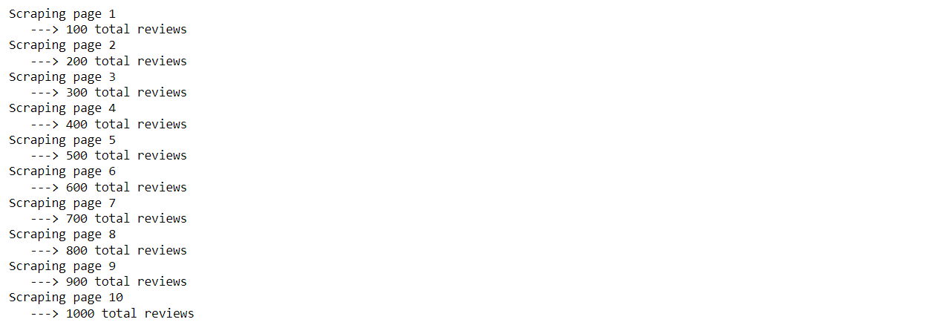
Done data analysis in Jupyter notebook includes some code to get you started with web scraping. We will use a package called `BeautifulSoup` to collect the data from the web. Once you've collected your data and saved it into a local `.csv` file you should start with your analysis.
Scraping data from Skytrax

Slide 3
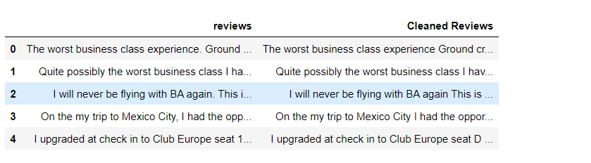
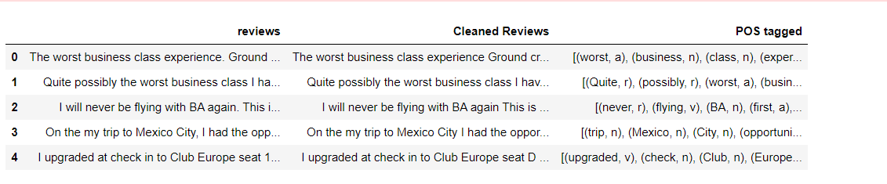
Cleaning the text
Tokenization, Enrichment – POS tagging, Stopwords removal, Obtaining the stem words

Slide 4
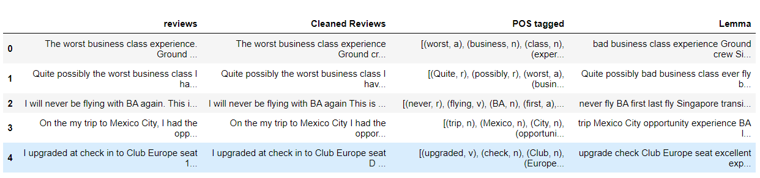
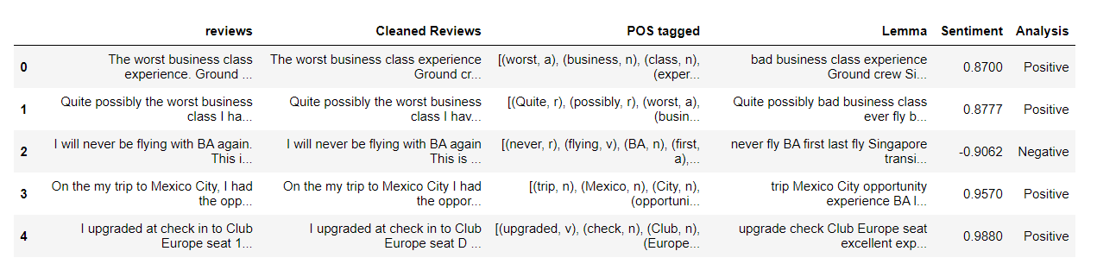
Lemmatization
Sentiment Analysis using VADER

Slide 5
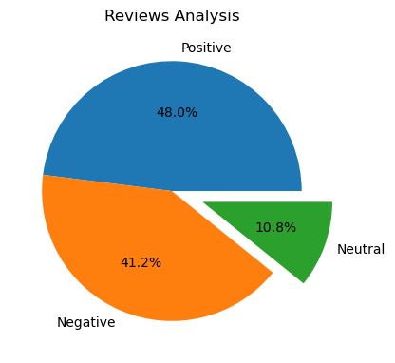
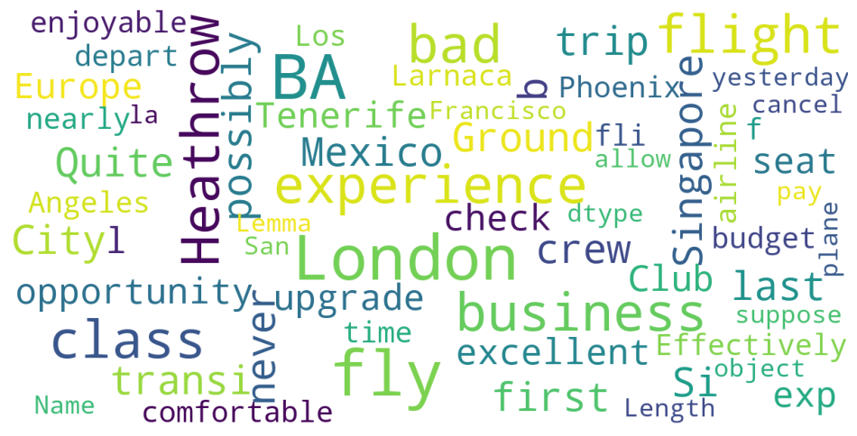
Visual Representation
Wordcloud Word Cloud or Tag Clouds

